Slide 1
Chapter 18
Probability Models
Lecture Slides

Slide 2
Case Study: Probability Models
Table 18.1 Probabilities of winning Super Bowl 53
Several websites posted the probabilities of winning Super Bowl 53 for the various NFL teams. These probabilities were updated regularly throughout the season.
Table 18.1 lists the opening probabilities posted on one website for the 2018 season.
Team | Probability
New England Patriots | 1/7
Los Angeles Rams | 1/11
Pittsburgh Steelers | 1/11
Philadelphia Eagles | 1/11
Minnesota Vikings | 1/13
Green Bay Packers | 1/13
San Francisco 49ers | 1/15
Houston Texans | 1/17
New Orleans Saints | 1/21
Dallas Cowboys | 1/21
Denver Broncos | 1/21
Atlanta Falcons | 1/21
Oakland Raiders | 1/26
Seattle Seahawks | 1/29
Carolina Panthers | 1/29
Kansas City Chiefs | 1/34
Team | Probability
Los Angeles Chargers | 1/34
Baltimore Ravens | 1/34
Indiana Colts | 1/34
Jacksonville Jaguars | 1/34
Tennessee Titans | 1/41
Detroit Lions | 1/41
New York Giants | 1/51
Tampa Bay Buccaneers | 1/51
Arizona Cardinals | 1/67
Chicago Bears | 1/81
Washington Redskins | 1/81
Cincinnati Bengals | 1/81
Buffalo Bills | 1/81
Miami Dolphins | 1/101
Cleveland Browns | 1/101
New York Jets | 1/101

Slide 3
Case Study: Probability Models (continued)
The probabilities in Table 18.1 are best interpreted as personal probabilities.
They are likely to change as the 2018 season progresses because the players on teams will change due to trades and injuries.
In this chapter, we will learn that probabilities must obey certain rules in order to make sense. By the end of this chapter, you will be able to assess whether the probabilities in Table 18.1 make sense.

Slide 4
Probability Models 1
The probability of any marital status is just the proportion of all women aged 25 to 29 who have that status. Here is a list of the probabilities.
Marital Status Probability
Never married 0.478
Married 0.476
Widowed 0.004
Divorced 0.042

Slide 5
Probability Models 2
This table gives a probability model for drawing a
young woman at random and finding out her marital status. It tells us what the possible outcomes are (there are only four), and it assigns probabilities to these outcomes.
Marital Status Probability
Never married 0.478
Married 0.476
Widowed 0.004
Divorced 0.042

Slide 6
Probability Models 3
We could compute the probability of not being married from this list.
P (not married) = P (never married) + P (widowed) + P (divorced) = 0.478 + 0.004 + 0.042 = 0.524
Our model does more than assign a probability to each individual outcome: We can find the probability of any collection of outcomes by adding up individual outcome probabilities.

Slide 7
Probability Models 4
A probability model for a random phenomenon describes all the possible outcomes and says how to assign probabilities to any collection of outcomes. We sometimes call a collection of outcomes an event.

Slide 8
Probability Rules 1
Any probability is a number between 0 and 1. Any proportion is a number between 0 and 1, so any probability is also a number between 0 and 1. An event with probability 0 never occurs, and an event with probability 1 occurs on every trial. An event with probability 0.5 occurs in half the trials in the long run.
All possible outcomes together must have probability 1. Because some outcome must occur on every trial, the sum of the probabilities for all possible outcomes must be exactly 1.

Slide 9
Probability Rules 2
C. The probability that an event does not occur is 1 minus the probability that the event does occur. If an event occurs in (say) 70% of all trials, it fails to occur in the other 30%. The probability that an event occurs and the probability that it does not occur always add to 100%, or 1.
D. If two events have no outcomes in common, the probability that one or the other occurs is the sum of their individual probabilities. If one event occurs in 40% of all trials, a different event occurs in 25% of all trials, and the two can never occur together, then one or the other occurs in 65% of all trials because 40% + 25% = 65%.

Slide 10
Example: Marital Status of Young Women
Look again at the probabilities for the marital status of young women. Each of the four probabilities is a number between 0 and 1.
Their sum is 0.478 + 0.476 + 0.004 + 0.042 = 1.
This assignment of probabilities satisfies Rules A and B.
Any assignment of probabilities to all individual outcomes that satisfies Rules A and B is legitimate.

Slide 11
Example: Marital Status of Young Women (continued)
Using rule C, the probability that the woman we draw is not married is
P (not married) = 1 − P (married) = 1 − 0.476 = 0.524
That is, if 47.6% are married, then the remaining 52.4% are not married.
Rule D says that you can also find the probability that a woman is not married by adding the probabilities of the three distinct ways of being not married, as we did earlier. This gives the same result.

Slide 12
Probability Rules 3
What about personal probabilities?
If your personal probabilities don’t obey Rules A and B, you are entitled to your opinion, but we can say that your personal probabilities are incoherent. That is, they don’t go together in a way that makes sense.
So we usually insist that personal probabilities for all the outcomes of a random phenomenon obey Rules A and B.

Slide 13
Probability and Odds 1
Speaking of sports, newspapers, magazines, and websites often give probabilities as betting odds in the form “Y to Z.”
This form means that a bet of $Z will pay you $Y if the team wins. If this is a fair bet, you expect that in the long run you should break even, winning as much money as you lose. In particular, if you bet Y + Z times, on average you should win $Y Z times and lose $Z the other Y times. Thus, on average, if you bet Y +Z times, you win Z of those bets. Odds of Y to Z therefore represent a probability of Z/(Y + Z) of winning.

Slide 14
Probability and Odds 2
Suppose the odds that the New England Patriots would win Super Bowl 53 are 6 to 1.
This corresponds to a probability of winning of 1/(6 + 1) = 1/7.
Suppose the odds that the San Francisco 49ers would win Super Bowl 53 are 14 to 1.
This corresponds to a probability of 1/(14+ 1) = 1/15.

Slide 15
Probability Models for Sampling
Choosing a random sample from a population and calculating a statistic, such as the sample proportion, is certainly a random phenomenon.
The distribution of the statistic tells us what values it can take and how often it takes those values.
That sounds a lot like a probability model.

Slide 16
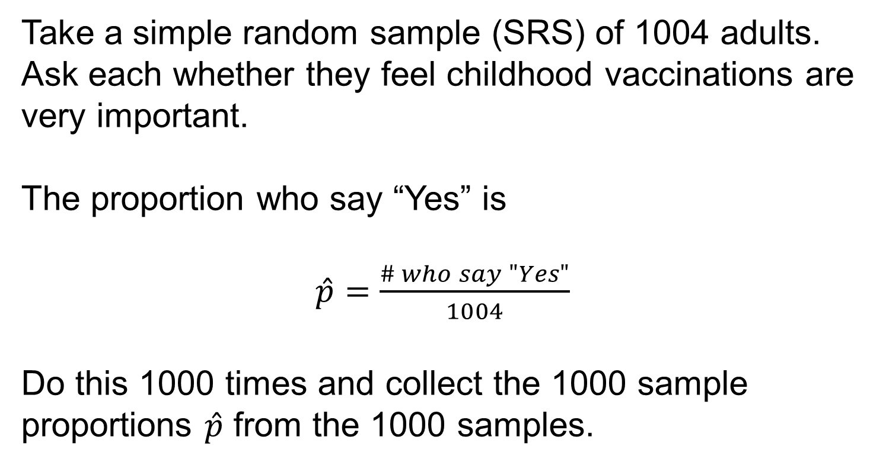
Example: A Sampling Distribution 1
Take a simple random sample (SRS) of 1004 adults. Ask each whether they feel childhood vaccinations are very important.
The proportion who say “Yes” is
$\hat{p}=\frac{\# who say "Yes"}{1004}$
Do this 1000 times and collect the 1000 sample proportions $\hat{p}$ from the 1000 samples.

Slide 17
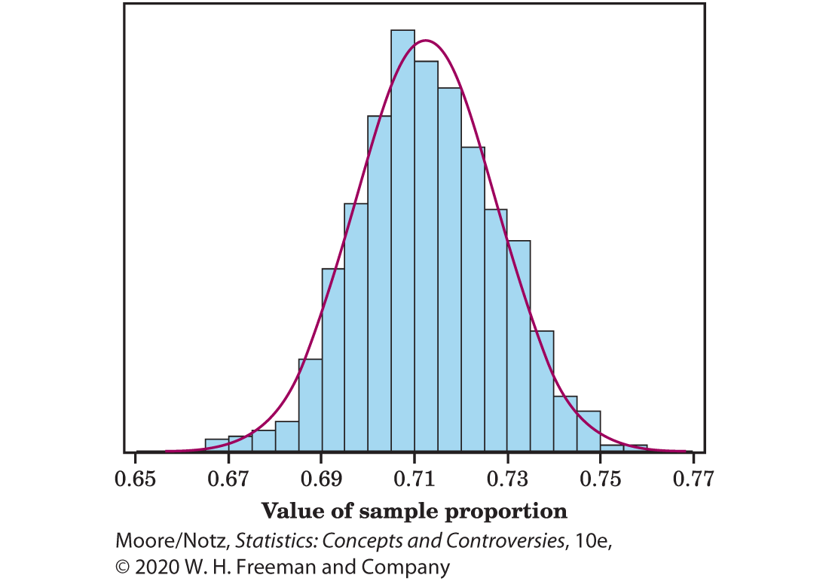
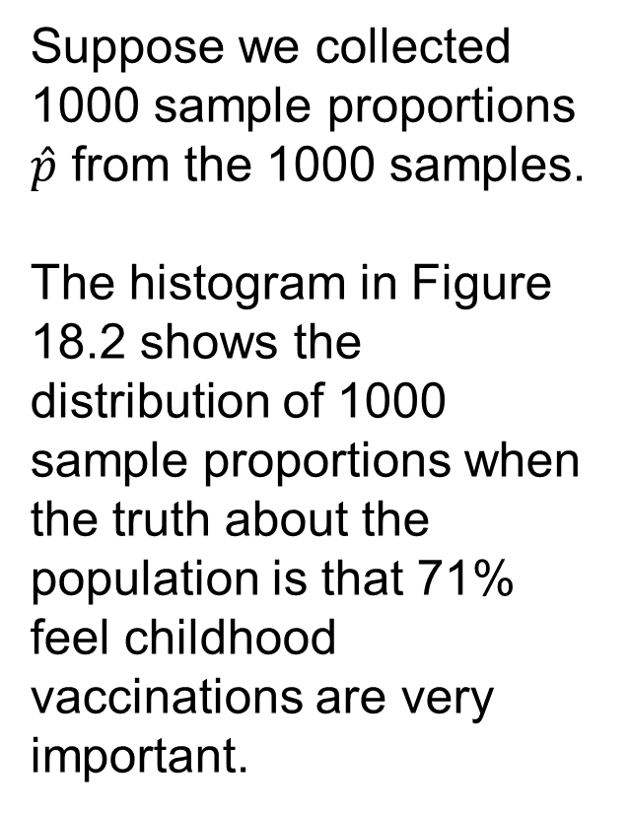
Example: A Sampling Distribution 2
Suppose we collected 1000 sample proportions $\hat{p}$ from the 1000 samples.
The histogram in Figure 18.2 shows the distribution of 1000 sample proportions when the truth about the population is that 71% feel childhood vaccinations are very important.

Slide 18
Example: A Sampling Distribution 3
This repetition reminds us that the regular pattern of repeated random samples is one of the big ideas of statistics.
The Normal curve in the figure is a good approximation to the histogram.
The histogram is the result of these particular 1000 SRSs.

Slide 19
Example: A Sampling Distribution 4
Think of the Normal curve as the idealized pattern we would get if we kept on taking SRSs from this population forever.
That’s exactly the idea of probability: the pattern we would see in the very long run.
The Normal curve assigns probabilities to sample proportions computed from random samples.

Slide 20
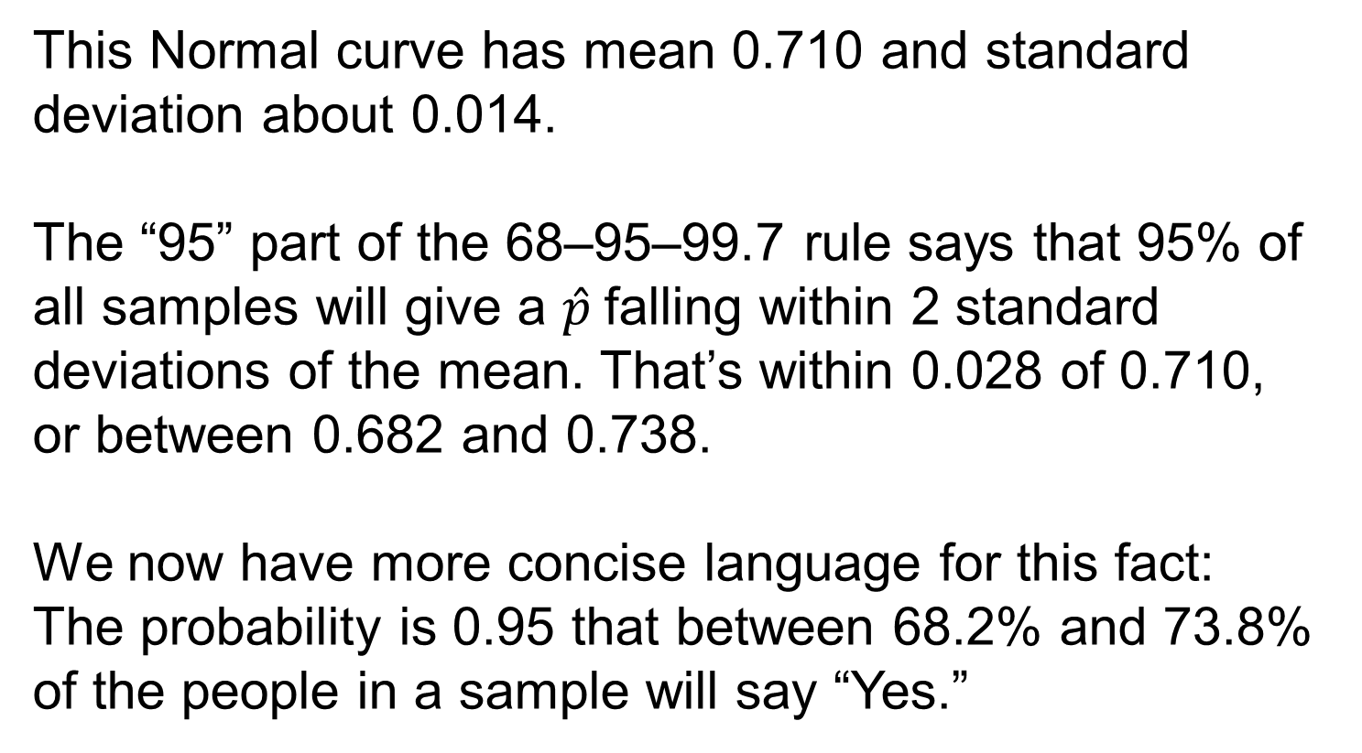
Example: A Sampling Distribution 5
This Normal curve has mean 0.710 and standard deviation about 0.014.
The “95” part of the 68–95–99.7 rule says that 95% of all samples will give a $\hat{p}$falling within 2 standard deviations of the mean. That’s within 0.028 of 0.710, or between 0.682 and 0.738.
We now have more concise language for this fact: The probability is 0.95 that between 68.2% and 73.8% of the people in a sample will say “Yes.”

Slide 21
Probability Models for Sampling 1
The word probability says we are talking about what would happen in the long run, in very many samples.
We note that of the 1000 SRSs, 94.3% of the sample proportions were between 0.682 and 0.738, which agrees quite well with the calculations based on the Normal curve.
This confirms our assertion that the Normal curve is a good approximation of the histogram in Figure 18.2.

Slide 22
Probability Models for Sampling 2
The sampling distribution of a statistic tells us what values the statistic takes in repeated samples from the same population and how often it takes those values.
We think of a sampling distribution as assigning probabilities to the values the statistic can take.
Because there are usually many possible values, sampling distributions are often described by a density curve such as a Normal curve.

Slide 23
Statistics in Summary 1
• A probability model describes a random phenomenon by telling what outcomes are possible and how to assign probabilities to them.
• There are two simple ways to give a probability model. The first assigns a probability to each individual outcome. These probabilities must be numbers between 0 and 1 (Rule A) and they must add to exactly 1 (Rule B). To find the probability of any event, add the probabilities of the outcomes that make up the event.

Slide 24
Statistics in Summary 2
• The second kind of probability model assigns probabilities as areas under a density curve, such as a Normal curve. The total probability is 1 because the total area under the curve is 1. This kind of probability model is often used to describe the sampling distribution of a statistic. This is the pattern of values of the statistic in many samples from the same population.
• All legitimate assignments of probability, whether data based or personal, obey the same probability rules. So the mathematics of probability is always the same.

Slide 25
Statistics in Summary 3
• Odds of Y to Z that an event occurs corresponds to a probability of Z/(Y + Z).

